Slide 1
Service Bus Durable Task Framework
Submitted By:
Setu Moye Biswas
Maticular no- 1099793

Slide 2
Waht is durable Task Framework
It provides developers to write code orchestrations in C# uisn .Net task framework.
It is used by Microsoft to reliably orchestrate long running provisioning, monitoring and management operations.

Slide 3
Main Features
Definition of code orchestrations in simple C# code
Automatic persistence and check-pointing of program state
Versioning of orchestrations and activities
Async timers, orchestration composition, user aided check pointing

Slide 4
Task of the project
Use console application in c#to upload file in Google Drive.
Task Orchestration by Durable Task Framework.

Slide 5
Fundamentals of Durable Task Framework
Task Hub: -it is logical continer for Service Bus entties used by the Task Hub Worker to pass messages reliably between the code orchestrations and the activities that they are orchestrating.
Task Activities: Task Activities are pieces of code that perform specific steps of the orchestration.
Task Orchestrations: schedule Task Activities and build code orchestrations
Task Hub Worker: host for Task Orchestrations and Activities.
Task Hub Client: Creating and managing APIs for Task Orchestration instances and querying the state of Task Orchestration

Slide 6
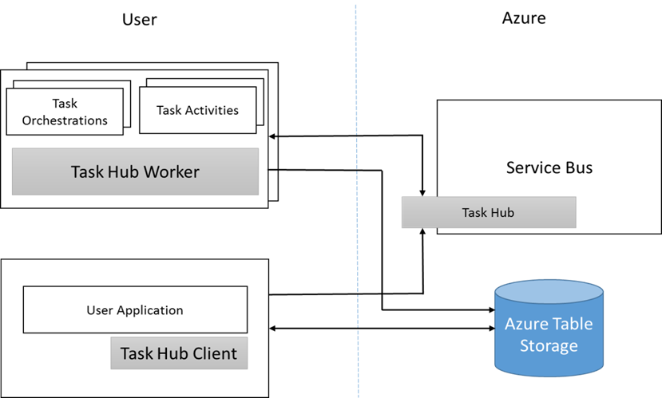
Core Components

